Slide 1
Economics of failure in movies after the Big Crisis
Rosamaria Bitetti
Luiss/OECD

Slide 2
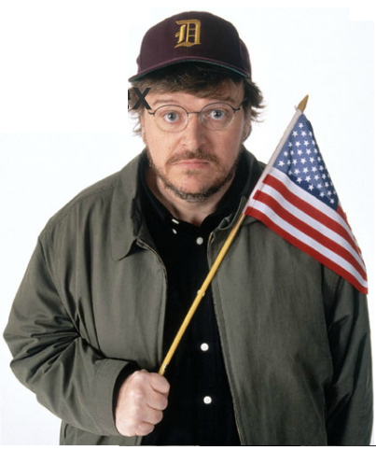
Capitalism: hollywood big villain
Negative attitude in filmakers toward the market
  Neutrality and complexity
  Self-selection
  Principal Agent Problem

Slide 3

Why shall we care?
Learning as a byproduct
Narrative vs Analytical mode of thought

Slide 4


Slide 5
How does it happen?
Complex representations:
  representation that appears clear enough to circulate widely within a population and thus become cultural, but whose contents and implications require expert knowledge, nonetheless, in order to be fully appreciated (Adamo 2009)
Murphy law of Economics:
  economists have the least influence on policy where they know the most and are most agreed and they have the most influence on policy where they know the least and disagree most vehemently

Slide 6
Questions:
Is the bias the reason why filmakers do not represent economics correctly?
How does the representation change with saliency?
Database approach, variable: economic failure.

Slide 7
Economics of failure, 101
World's 100 largest industrial companies (1912-1995)
- 52 survived
- 28 become larger
- 19 remained in the top 100
- 48 disappeared
- 29 went bankrupt (Hannah)
S&P 500 index: from 75 years in 1937 to 15 years today

Slide 8
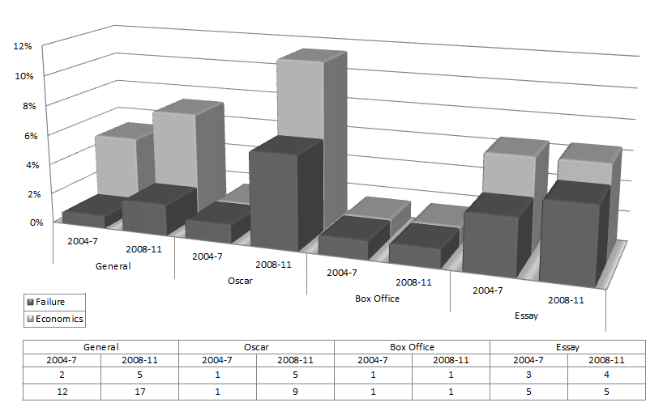
The Database

Slide 9
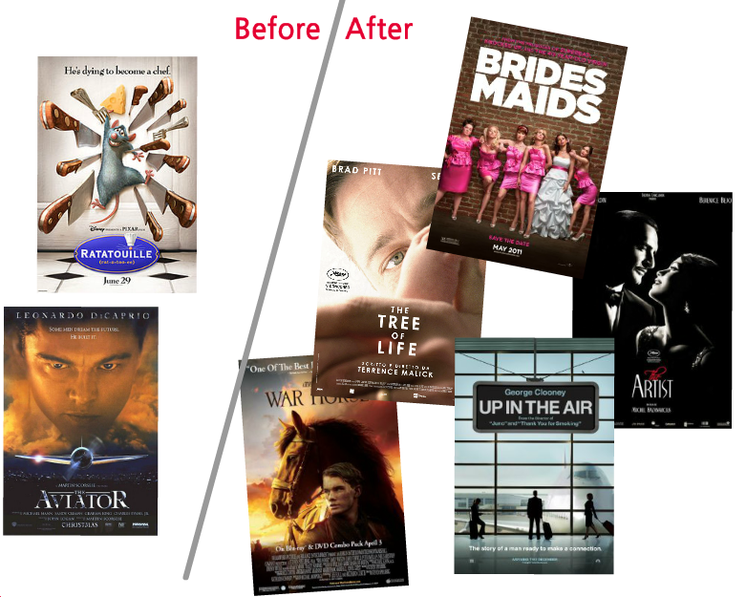

Slide 10

Case study 1: The Artist
Pro-Business
Correct representation of economic failure
Schumpeterian concept

Slide 11
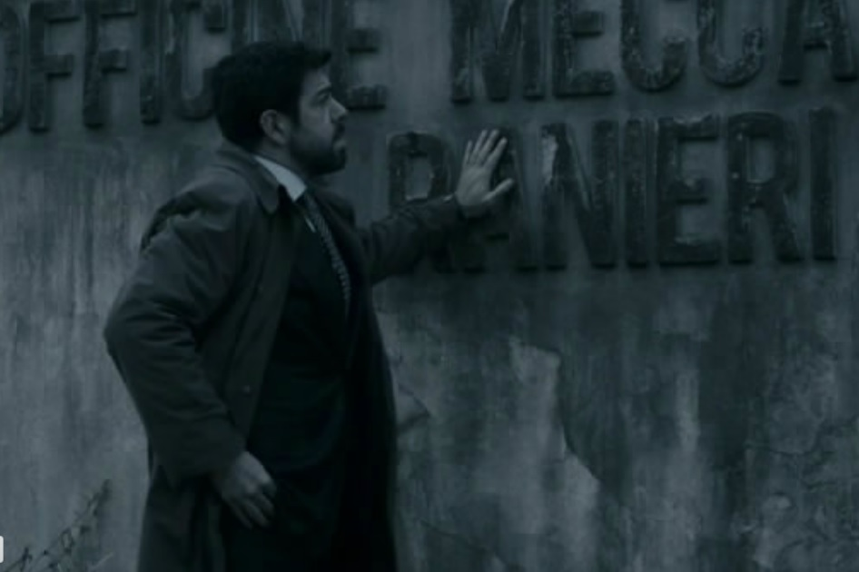
Case study 1: The Entrepreneur
Pro-Business
Failure as injustice
Anti-Takeover, negative interpretation of non-materialistic

Slide 12

Case study 3: Wall Street – Money never sleeps
Anti-Business
Mistaken representation of economic failure
Financial Crisis

Slide 13
Conclusion
Filmakers are influenced by the principal-agent problem in their selection of the topic, but correct economic representation depends on their own narratives, with more distortion the easier is the concept (complex representations).

Slide 14
Why shall we care?
If our social science is to yield fruits in an improved quality of human life, it must for the most part be "sold" to the masses first. The necessity of making its literature not merely accurate and convincing, but as nearly "fool-proof " as possible, is therefore manifest.
          Frank Knight

Slide 15
Thanks!
Rosamaria Bitetti
rosamaria.bitetti@gmail.com

